Slide 1


Problem Statement
HOW MIGHT WE CREATE A BETTER WAY FOR BANK CUSTOMERS TO UNDERSTAND THEIR FINANCIAL POSITION?
Presentation by AWB_

Slide 2

OUTLINE
Research
Survey Analysis
Proposed Solution
Concept Poster
Future Works

Slide 3

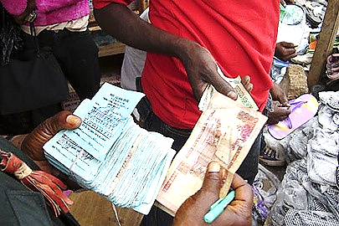


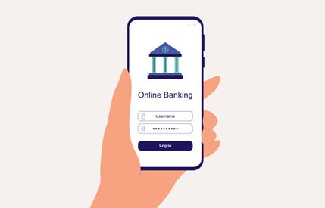
PROGRESSION IN THE BANKING SECTOR
Document-based Record
ATM
Bank Queue
Online Or Mobile Banking

Slide 4

ONLINE RESEARCH
In our research we found out that, in a nationwide financial literacy assessment, the Ministry of Finance in Ghana discovered that a significant portion of the population struggles with understanding key financial.
Awareness and usage of financial products and services: A large number of Ghanaians are not well-informed about the various financial options available to them, which can lead to underutilization of beneficial financial services
72%

Slide 5


USER-FOCUSED DESIGN APPROACH
Project Begin
Initiating The Project.
User Study And Insight Gathering.
Design Concept Development.
Prototype User Evaluation.
Comprehensive Design Development.
Build And Evaluate

Slide 6
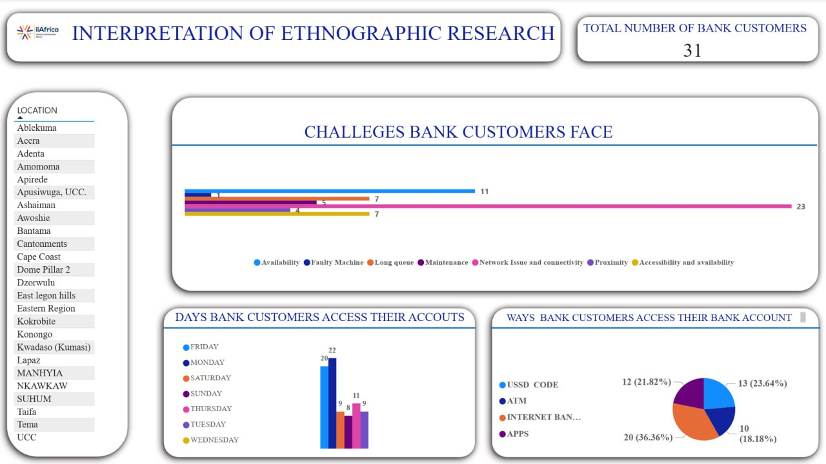

Slide 7


SURVEY ANALYSIS
Key Preferred Method to Access Accounts
From our survey,internet Banking is the most preferred method for accessing bank accounts.
Key Problem Faced by Users
Internet Connectivity and Network Issues are the most significant problems, affecting both USSD code usage and internet banking/app services
Key Improvements Desired
Respondents desire enhancements in digital service reliability and functionality.
BRAINSTORM
SESSION

Slide 8




PROPOSED SOLUTION
eTC
Home
Photo
About Us
Contact
Revolutionary
banking
eTC
80%
90%
Explore Now
Play Video
All Banks in one place
Modified Banking transactions
Body

Slide 9
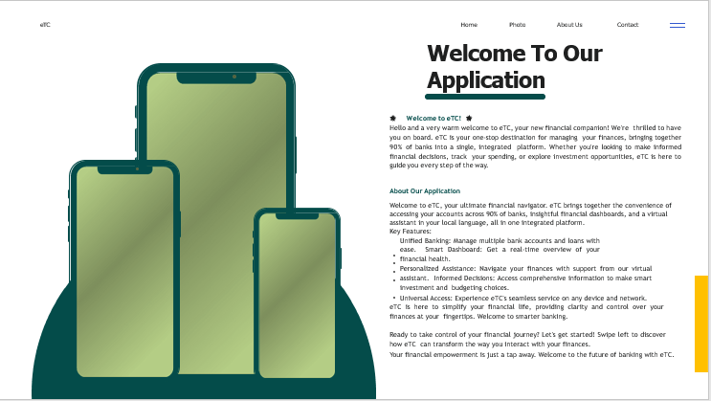


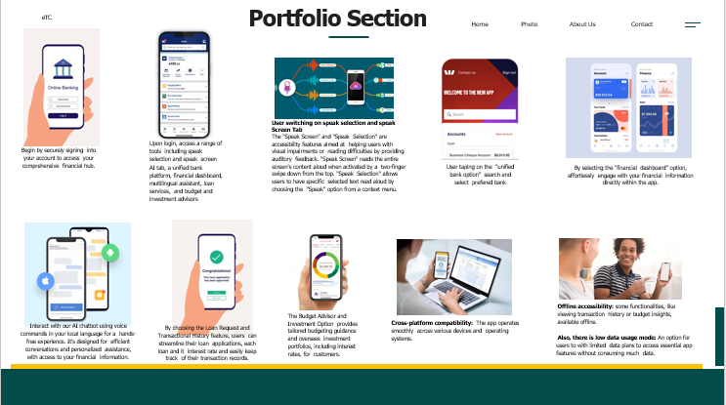
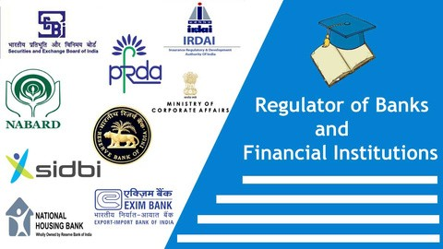

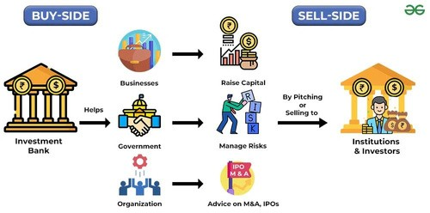
Concept Poster
PROBLEM STATEMENT
How could we create a user- focused solution that makes understanding one's financial status simpler, offering clear insight and tranquility?
IDEA
KEY STAKE HOLDERS
Bank customers
Banks
Regulatory bodies
Development team
Investors

Slide 10




eTC
Home Photo About Us
Welcome To Our Application
Contact
🌟 Welcome to eTC! 🌟
Hello and a very warm welcome to eTC, your new financial companion! We're thrilled to have you on board. eTC is your one-stop destination for managing your finances, bringing together 90% of banks into a single, integrated platform. Whether you're looking to make informed financial decisions, track your spending, or explore investment opportunities, eTC is here to guide you every step of the way.
About Our Application
Welcome to eTC, your ultimate financial navigator. eTC brings together the convenience of accessing your accounts across 90% of banks, insightful financial dashboards, and a virtual assistant in your local language, all in one integrated platform.
Key Features:
Unified Banking: Manage multiple bank accounts and loans with ease. Smart Dashboard: Get a real-time overview of your financial health.
Personalized Assistance: Navigate your finances with support from our virtual assistant. Informed Decisions: Access comprehensive information to make smart investment and budgeting choices.
Universal Access: Experience eTC's seamless service on any device and network.
eTC is here to simplify your financial life, providing clarity and control over your finances at your fingertips. Welcome to smarter banking.
Ready to take control of your financial journey? Let's get started! Swipe left to discover how eTC can transform the way you interact with your finances.
Your financial empowerment is just a tap away. Welcome to the future of banking with eTC.

Slide 11
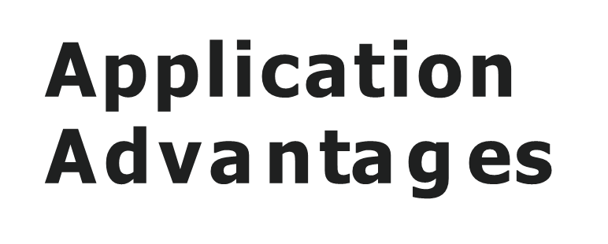




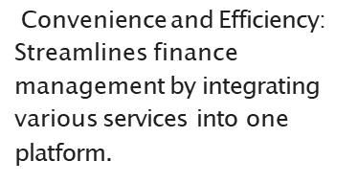







eTC
Home
Photo
About Us
Contact
Application
Features
01
01
An integrated platform for all banks.
02
Financial dashboard
Personalized Financial insight:
Offers tailored financial
insights to help users make informed decisions.
A Virtual Assistant offering Speak Selection and Speak Screen features in multiple local languages
03
Enhanced Financial
Accessibility: Ensures universal access on any device and supports local languages, making
04
Loan request access and transactional history
05
Budget Advisor and Investment Portfolio
Security and Privacy: Prioritizes user data protection with advanced security measures, fostering trust and reliability.
06
Interconnectivity with all network.
07
Automatically installs with system update for easy access

Slide 12
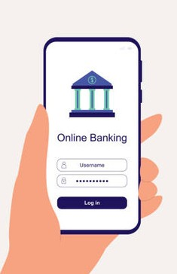
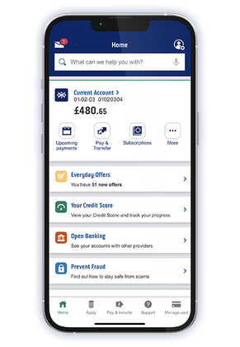
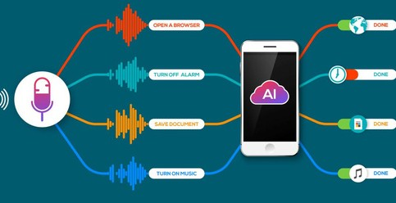
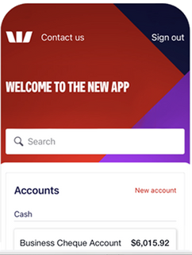
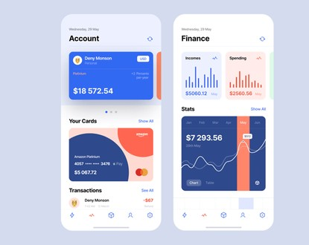
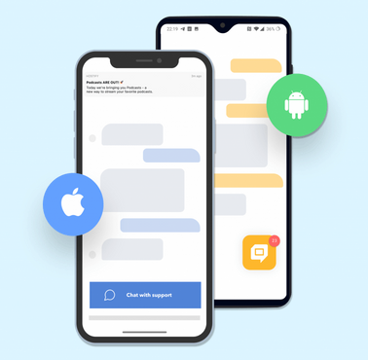
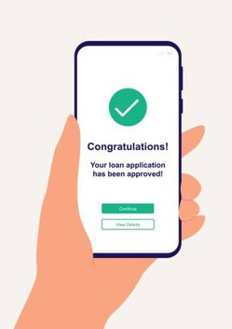
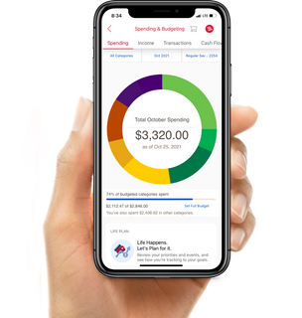
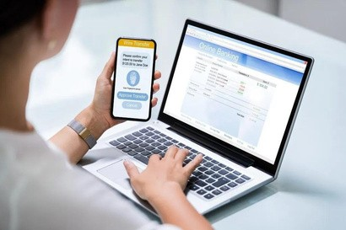

Portfolio Section
eTC
Home
Photo
About Us
Contact
User switching on speak selection and speak
Screen Tab
Upon login, access a range of tools including speak selection and speak screen AI tab, a unified bank platform, financial dashboard, multilingual assistant, loan services, and budget and investment advisors
The "Speak Screen" and "Speak Selection" are accessibility features aimed at helping users with visual impairments or reading difficulties by providing auditory feedback. "Speak Screen" reads the entire screen's content aloud when activated by a two-finger swipe down from the top. "Speak Selection" allows users to have specific selected text read aloud by choosing the "Speak" option from a context menu.
Begin by securely signing into your account to access your comprehensive financial hub.
User taping on the “unified bank option” search and select prefered bank
By selecting the “financial dashboard” option, effortlessly engage with your financial information directly within the app.
Offline accessibility: some functionalities, like viewing transaction history or budget insights, available offline.
Also, there is low data usage mode: An option for users to with limited data plans to access essential app features without consuming much data.
The Budget Advisor and Investment Option provides tailored budgeting guidance and oversees investment portfolios, including interest rates, for customers.
Cross-platform compatibility: The app operates smoothly across various devices and operating systems.
Interact with our AI chatbot using voice commands in your local language for a hands-free experience. It's designed for efficient conversations and personalized assistance, with access to your financial information.
By choosing the Loan Request and Transactional History feature, users can streamline their loan applications, each loan and it interest rate and easily keep track of their transaction records.

Slide 13

SECURITY MEASURES
POSSIBLE REASONS FOR FAILURE
Poor User Experience
Ignoring User Feedback
Technical Issues
Poor Data Security and Privacy Practice
Inadequate Funding or Resource Allocation
End-to-End Encryption
Biometric Authentication
Two-Factor Authentication
Fraud Detection
Algorithms Automatic
Security Updates Data
Encryption
Access Control
Regular Updates and
Patches Network
Segmentation, Monitoring and Auditing

Slide 14





eTC
Home
Photo
About Us
Contact
Thank You

Slide 15
Reference
Ministry of Finance, Ghana. "Financial Literacy Education Campaign to Ignite Responsiveness of Consumers Held." Ministry of Finance | Ghana, 29 Aug. 2023, www.mofep.gov.gh/news-and-events/2023-08-29/financial-literacy-education-campaign-to- ignite-responsiveness-of-consumers-held&#8203;``【oaicite:1】``&#8203;.
CDC Group. "Financial Literacy Campaign In Ghana." CDC Consult, 24 May 2023, cdcconsult.com/financial-literacy-campaign-in- ghana.

